Slide 1

Challenges in data distribution and Analysis with the Solar Dynamics Observatory
Alisdair Davey, Paola Testa,
& SDO Feature Finding Team
AstroStat workshop – Cambridge, August 25 2010

Slide 2
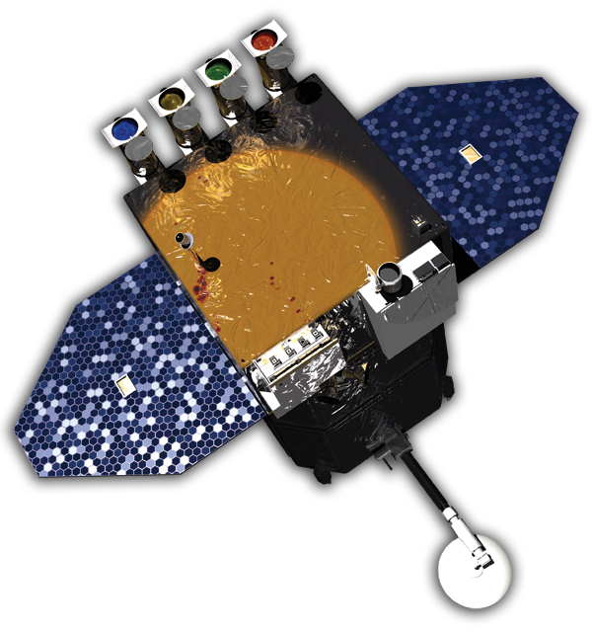
The Solar Dynamics Observatory
AIA: the Atmospheric Imaging Assembly images the solar atmosphere in narrow passbands in EUV and UV, with high temporal cadence (~12 s).
AIA
HMI
EVE: the Extreme Ultraviolet Variability Experiment measures the solar EUV spectral irradiance to understand variations on the timescales which influence Earth’s climate and near-Earth space.
EVE
HMI: the Helioseismic and Magnetic Imager studies oscillations and the magnetic field at the solar photosphere

Slide 3
The Solar Dynamics Observatory
AIA:
full Sun images 4K × 4K
8 (2/telescope) images every ~12s
~2Tb/day of uncompressed data
AIA
HMI
channel
94Å
131Å
171Å
193Å
211Å
304Å
335Å
ions
Fe XVIII,X
Fe VIII, XX, XXIII
Fe IX
Fe XII, XXIV
Fe XIV
He II
Fe XVI
Log (T[K])
6.8, 6.0
5.6, 7.0, 7.2
5.8
6.1, 7.3
6.3
4.7
6.4
EVE

Slide 4
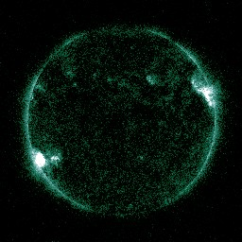
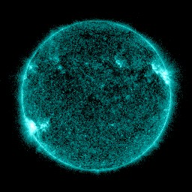
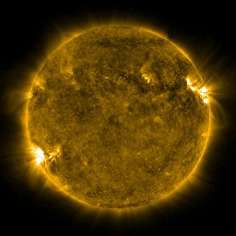
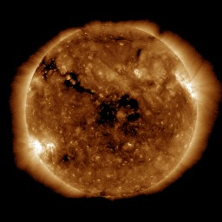
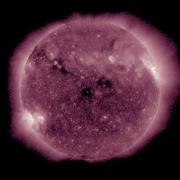
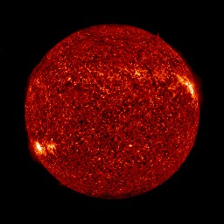
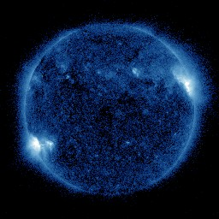
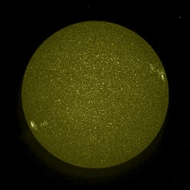
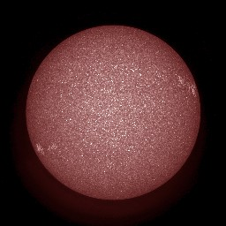
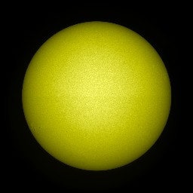
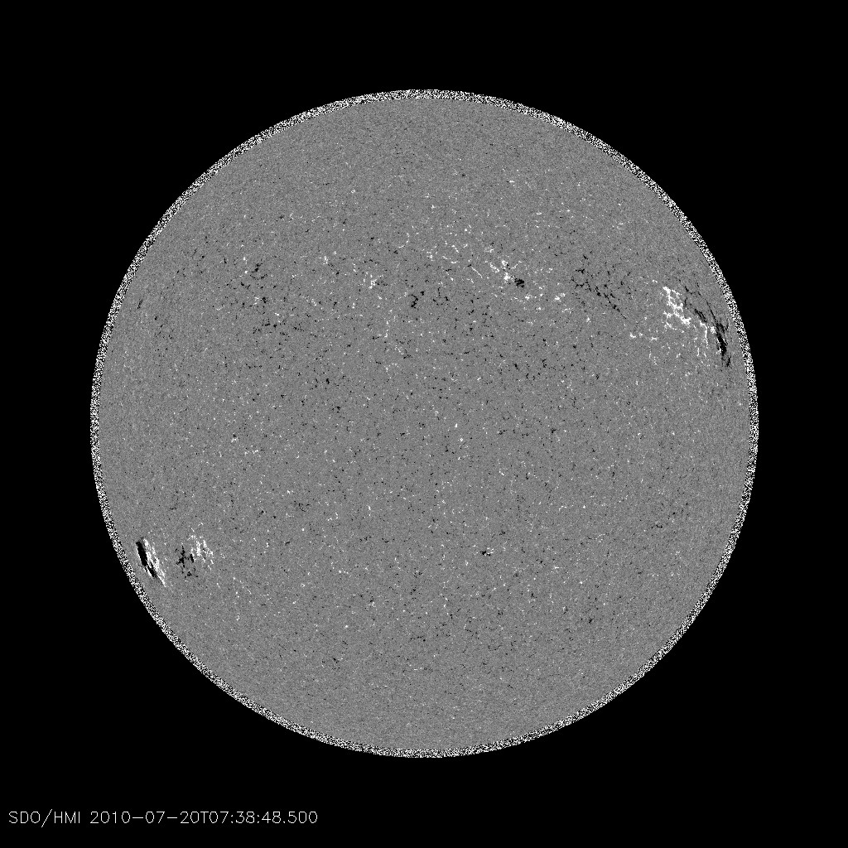
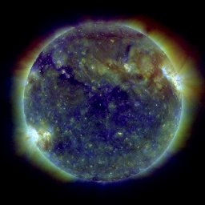
The wonderful challenge we have!

Slide 5
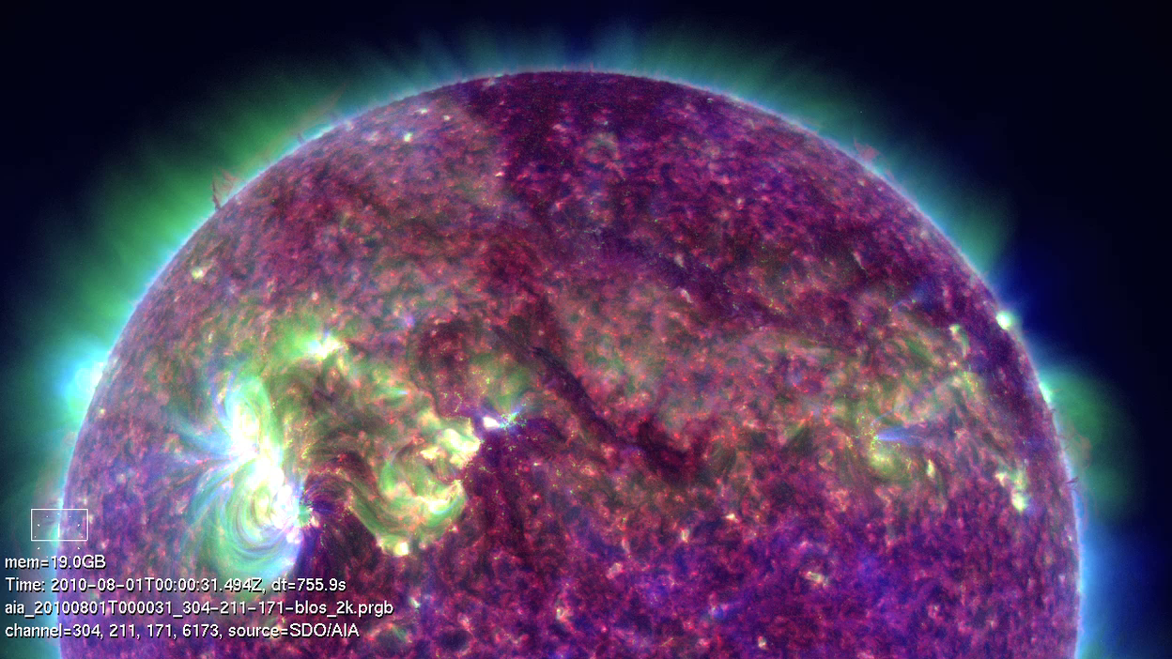
The Solar Dynamics Observatory
AIA HeII-FeXIV-FeIX
http://sdowww.lmsal.com

Slide 6
The Solar Dynamics Observatory
http://sdowww.lmsal.com

Slide 7
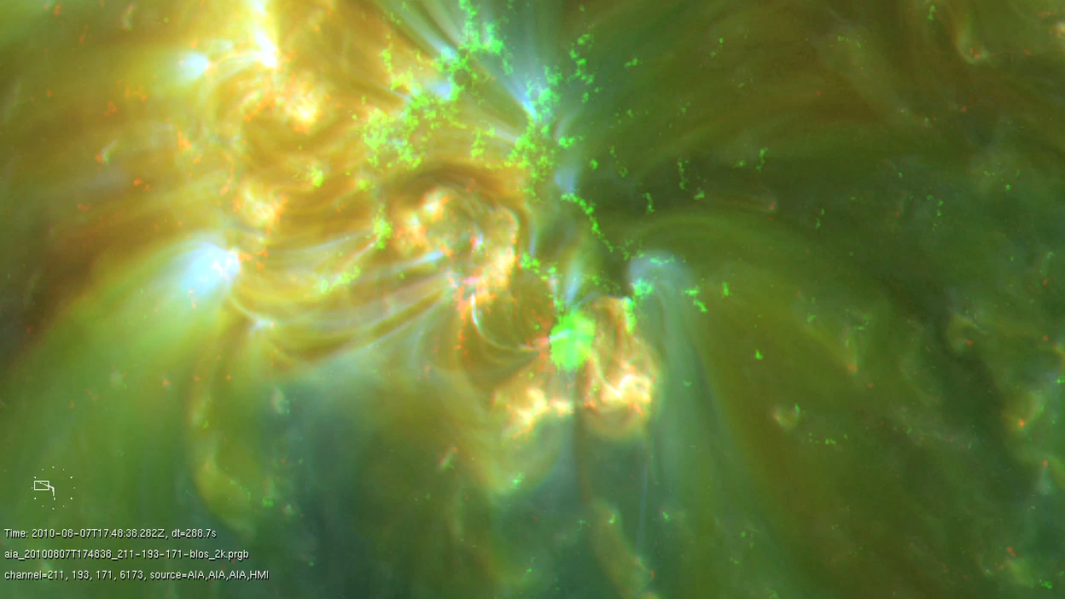
The Solar Dynamics Observatory
http://sdowww.lmsal.com
AIA 211A-193A-171A

Slide 8
Challenges of SDO Data Sharing
Large amounts of data! Currently approximately 700 Gig per day fully compressed. (AIA + HMI Series)
“All” the data, only available from the AIA-HMI Joint Science Operation Center (JSOC) (on disk and tape)
  Bottleneck?
If you wanted to distribute the SDO data then would need bandwidth and storage capability.
  Commodity Internet not good enough
Initially there was no model for distributing the data!
But … there are sites with the bandwidth and enough storage to create a cache of SDO data …

Slide 9
SDO Data Storage
How is the data stored? (not in FITS file!)
  SDO data storage is done using two databases, DRMS (Data Record Management System) and SUMS (Storage Unit Management System).
  DRMS - contains all the meta information about a particular observation (maps to FITS header). Data is organized in series of like observations
  SUMS - contains information on the layout of image segments on disk or on tape.
Controlled using DRMS software written by JSOC.

Slide 10
Flow of SDO Image Data
SDAC
Meta data is copied from
JSOC to each site.
JSOC
AIA/HMI
SAO
ROB
UCLan
IAS
HMI
NSO
HMI
KIP
MPS

Slide 11
DRMS Database Triggers
Used to:
  Populate table used by JMD to work out which SUMS units to copy
  Populate table used by VSO (Virtual Solar Observatory) to respond to data queries
Customizable to each site:
  Only want 171Å and 304Å images
  Only want images in all wavelengths at 5 min cadence

Slide 12
Locations of Sites With SDO Data
JSOC - Stanford / LMSAL
Smithsonian Astrophysical Observatory
National Solar Observatory (NSO)
NASA Solar Data Analysis Center (SDAC)
Royal Observatory Belgium (ROB)
University College Lancashire (UCLan)
Max Planck Institute for Solar System Research (MPS)
Institute d'Astrophysique Spatiale - Orsay (IAS)
Kippenheuer Institute (KIP)
ROB, UCLan and IAS will also become VSO nodes

Slide 13
Integrating SDO Data With Virtual Solar Observatory
Web Interface
  General
    New general interface
  SDO Specific
  Geolocation
IDL
  Concentration of effort
  VSO_SEARCH
  VSO_GET
New VSO Nodes
  ROB, UCLan, IAS will become VSO nodes as well as SDO data providers

Slide 14
IDL Examples
Basic Search
IDL> a = vso_search( '2010-06-10', '2010-06-10 00:05', inst='aia’,
pixels=4096 )
Find observation nearest DATE, get rice compressed data
IDL> a = vso_search( near='2010-06-30', inst='aia', wave=171,
pixels=4096 )
IDL> b = vso_get( a, /rice )
Get data on a reduced cadence
IDL> a = vso_search( '2010-06-10', inst='aia', wave=171, level='1.0',
sample=3600 )
Notes:
Should we hide this slide?

Slide 15
Distributed Data Search and Retrieval - Why VSO Is Good For You!
Aim is to send you to the most sensible site
Through SLONY log mirroring and DB triggers all participating sites can answer queries for SDO Data
All sites know where the data are
Query search site for data, then locate it at other sites.
Stanford is site of last resort
Will pull over data to requesting site so next time more than one site has it
Ability to retain frequently requested data indefinitely
As usual VSO will take care of the where and the how and will deliver you the data as fast as it can be gotten!

Slide 16
Using Other Tools To Access SDO Data
http://www.jhelioviewer.org

Slide 17
A Different Approach to Data Discovery
Scientists often browse through data looking for events.
  Will analyze numbers of events and turn them into science catalogs
Start with feature or event and extract data cube for analysis
  Heliophysics Event Knowledgebase (HEK)
  “The HEK is designed to catalogue interesting solar events and features and to present them to members of the solar physics community in such a way that guides them to the most relevant data for their purposes.”
NASA awarded team led by SAO a four year grant to provide a suite of modules for automated feature recognition and analysis for the imagery from the Solar Dynamics Observatory. (Helioseismology data are handled by another team).

Slide 18
SDO Feature Finding Team
Smithsonian Astrophysical Observatory
Lockheed Martin
Montana State University
Southwest Research Institute
Johns Hopkins APL
Marshall Space Flight Center
Royal Observatory Belgium
Academy of Athens
Trinity College Dublin
Max Planck Institute for Solar System Research

Slide 19
SDO FFT - The Modules
Flares
Coronal Dimmings,
Magnetic Feature Tracking (from sunspots to micro-pores),
Sunspots,
Active Regions,
Coronal Holes,
Filaments (H-alpha data),
Sigmoids,
CME’s (LASCO data),
Jets,
X-ray Bright Points,
EIT waves,
Coronal Oscillations
Mapping Polarity Inversion Lines
Full Disk Non-Linear Force-Free Field Extrapolations.
Trainable Feature Recognition Module

Slide 20
Feature Detection - How It Runs
SDO Event Detection System (EDS).
  The basic purpose of the EDS is to analyze the SDO imagery for events and features as soon as the data reach the JSOC, i.e. in near-real time.
  Written in Java, but uses JAVA/IDL bridge to run IDL modules.
  Automatically runs modules with required files on specified cadence and with specified wavelengths.
  Stores state between runs.
  Metadata produced by software modules stored in HEK.
Solar scientists will be able to use the HEK to select event and feature data to download for science studies. This can be done using a cut-out service or via the Virtual Solar Observatory (VSO).

Slide 21
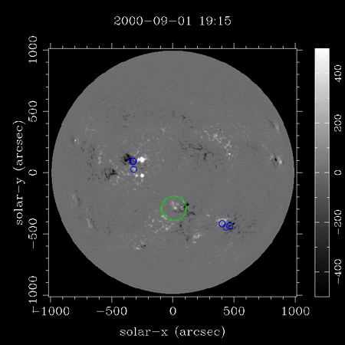
Some Examples - Emerging Flux Regions

Slide 22


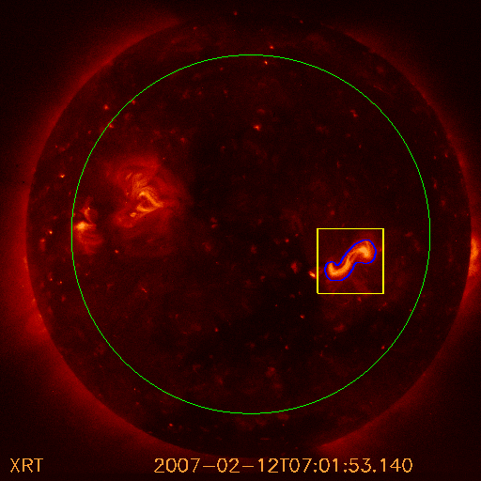
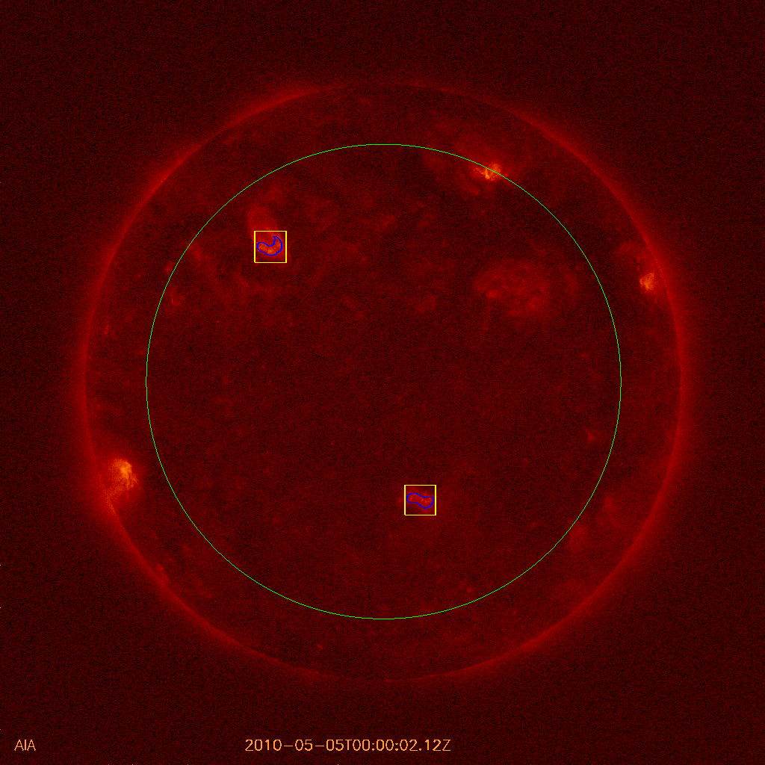
Sigmoid Sniffer
Sigmoids detected with the sigmoid sniffer in a Hinode/XRT image (left) and AIA(right, 94 A). The sigmoid sniffer is set up for both XRT and AIA images.

Slide 23
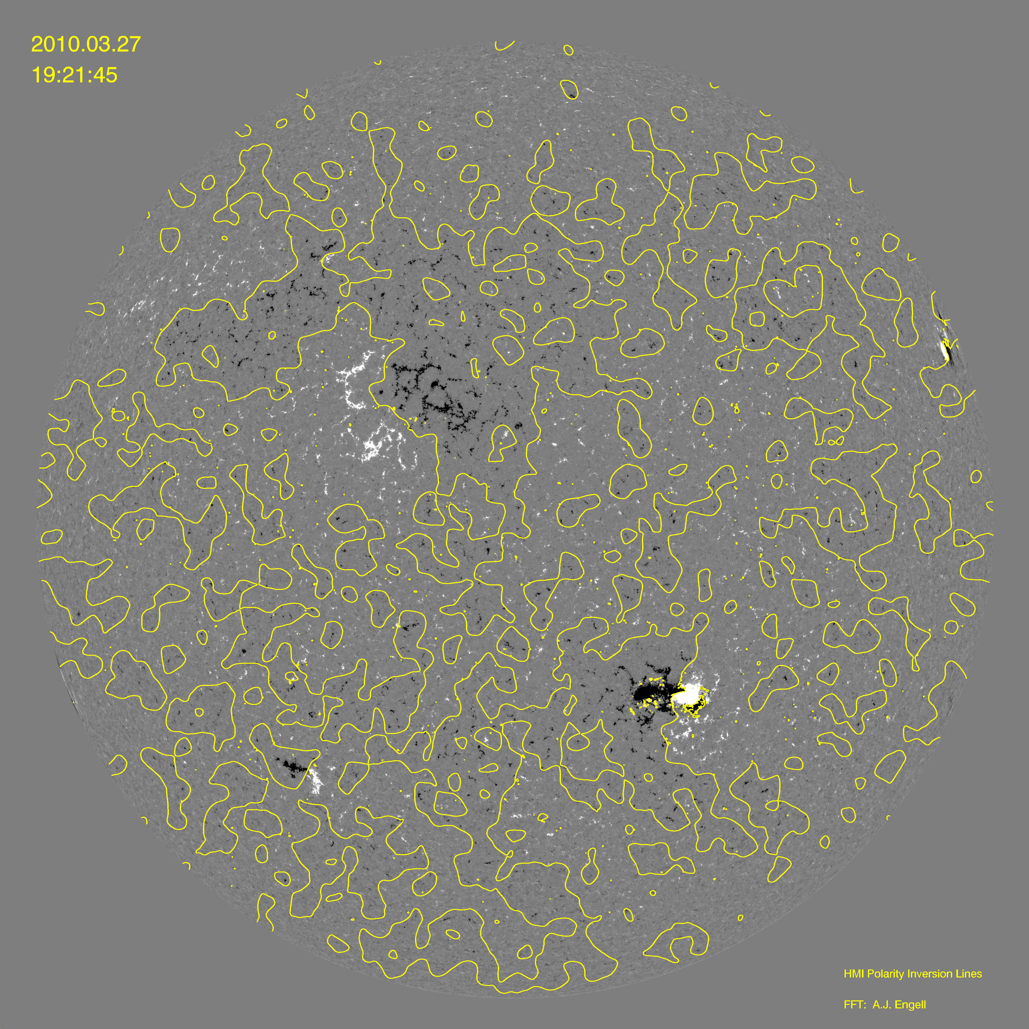
Some Examples – Polarity Inversion Line

Slide 24
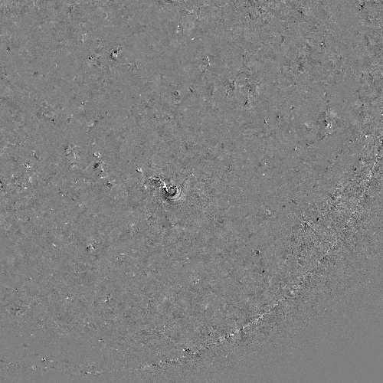
Some Examples – Dimming Regions

Slide 25
Targets of FFT Output
HEK
  Find datasets by using already found features and events.
  Bright Points and Flux elements send Neal running, screaming!
  Not designed for large scale correlation studies.
Space Weather Triggers (Special case of HEK)
  Flares, dimming regions and emerging flux regions.
  Multiple notifications for one event submitted.
Science Catalogs
  VSO Tools for Catalog Display and Query (including correlation tools).

Slide 26
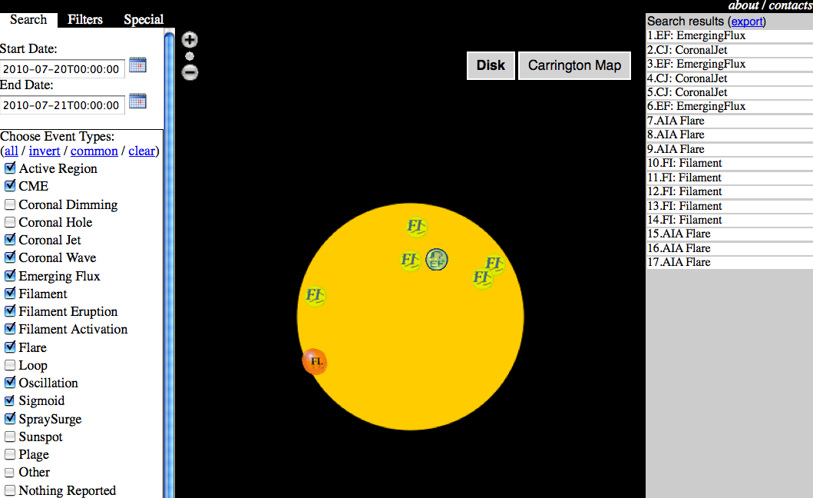
HEK - iSolSearch

Slide 27
Trainable Solar Feature Recognition Modules
Conundrum: By showing examples we can teach an undergraduate in ten minutes what a filament, sunspot, sigmoid, or bright point looks like, and instruct them to build a catalog from a data series. Yet teaching a computer the same is a very time consuming job – plus it remains just as demanding for every new feature.
Conclusion: Humans have fantastic generic feature recognition capabilities. (Main reason we survived the plains of East Africa).
Challenge: Can we design a computer program that has “human” generic feature recognition capabilities?
Answer: This has been done, with considerable success, in interactive diagnosis of mammograms, as an aid in early detection of breast cancer.
Method (example): Divide a mammogram in a suitable number of sub-images. For each sub-image calculate a number of “texture” parameters, such as entropy, relative smoothness, uniformity, kurtosis, etc. (all exactly defined mathematically). Sick tissue looks different from healthy tissue, that is why doctors can diagnose it.
Eureka!: Sick and healthy tissue also take up different regions in the space spanned by the “texture” parameters. → Automated diagnosis!

Slide 28
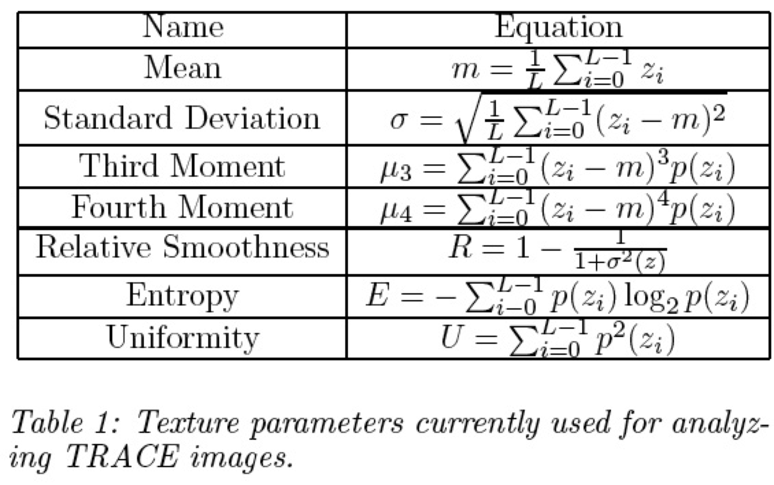
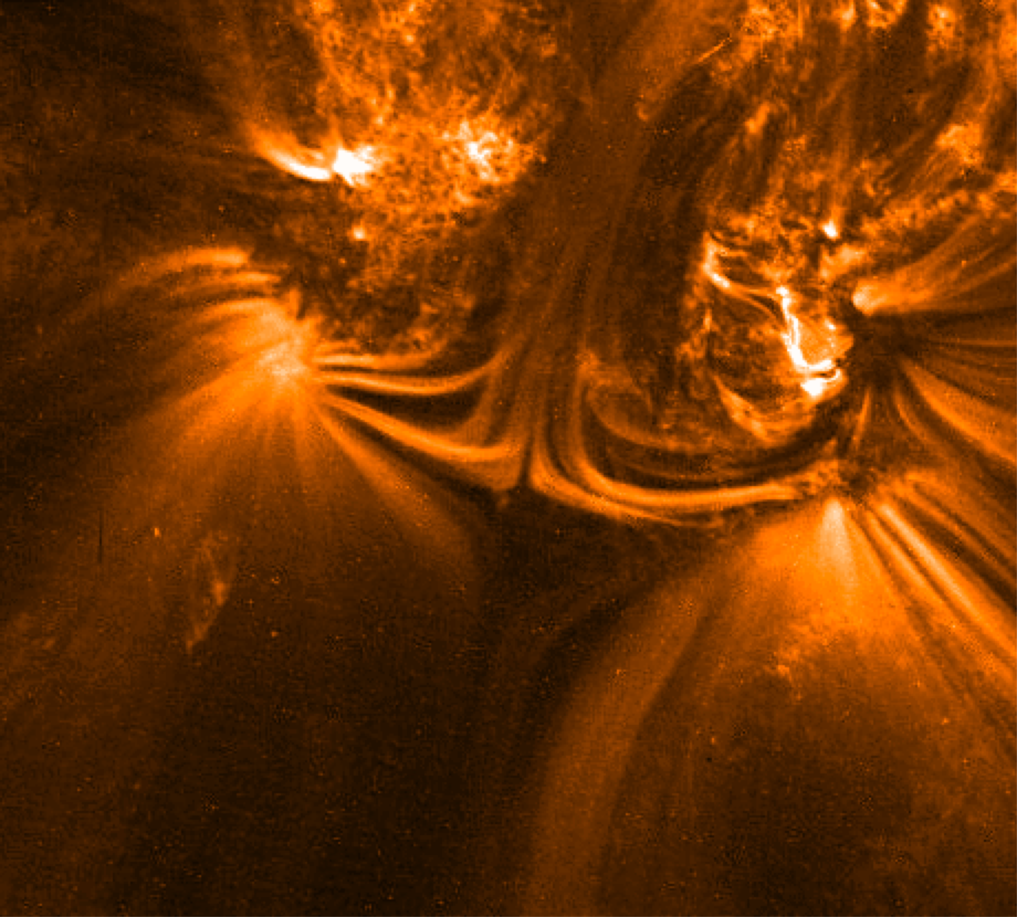
Trainable Solar Feature Recognition Modules
Detect features for which we have no dedicated codes: loops, arcades, plumes, anemones, key-holes, faculae, surges, arch filaments, delta-spots, cusps, etc.
Detect features that we have not discovered yet, like sigmoids were in the pre-Yohkoh era. (No need to reprocess all SDO images!)
Cross-comparisons with the dedicated feature recognition codes, to quantify accuracy and precision.
Observe a feature for which we have no clear definition yet, and find features “just like it”. E.g. the TRACE image right, with a magnetic null-type geometry.

Slide 29
FFT - Verification
Reproducibility
  Even if it’s wrong it’s reproducibly wrong!
By hand / eye
  By publication of results - peer review
  Previous instrument data sets
  Calibration to AIA/HMI - throws up interesting problems
    AEC - Flare finding / 46 Dimming Regions
Modules are not frozen
  Expect modules to be updated with improvements to code.
  Code is versioned
  If results updated, old events not thrown away
Codes available to the community

