Slide 1




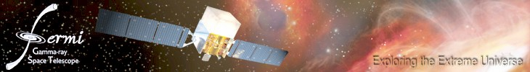
Adventures in Modern Time Series Analysis
From the Sun to the Crab Nebula and Beyond
Jeffrey.D.Scargle@nasa.gov
Brad Jackson, Jay Norris, Jim Chiang, Tom Loredo, Joe Bredekamp
Alanna Connors
Applied Information Systems Research Program (NASA)
Keck Institute for Space Studies (Caltech)
Institute for Pure and Applied Mathematics (UCLA)
Center for Applied Mathematics and Computer Science (SJSU)
Statistical and Mathematical Sciences Institute (Duke)
Banff International Research Station
NASA Ames Research Center

Slide 2
Outline
Time Series Analysis in the Age of Digital Astronomy
Case Study: BATSE Gamma Ray Burst Data
The Bayesian Blocks Algorithm
Fermi Gamma Ray Space Telescope
Activity in the Crab Nebula
Edelson and Krolik DCF ➔Time Series Explorer
Active Galactic Nuclei with Kepler and Fermi
Chromospheric Activity over 3+ Solar cycles
Multi-scale Structure of the Galaxy Distribution

Slide 3
Astronomical Time Series Analysis Issues
Uneven Sampling
Data Gaps
Observational Errors
Variable Observational Errors - “heteroskedasticity”
Exposure Variation
Data Modes: Events, Bin Counts, Measurements, …
Background
Multivariate Time Series
Data on the Circle

Slide 4
Time-Tags for Photons from BATSE Burst 0551
229 370 542 814 1025 1223
270 409 682 834 1033 1250
274 412 701 838 1074 1268
281 422 712 880 1103 1269
291 458 732 884 1127 1275
322 470 735 981 1156 1291
…
289454 289457 289486 289500 289582 289645
289652 289689 289691 289698 289738 289744
289758 289759 289776 289778 289779 289804
Unit: 2 microseconds Origin: Trigger time

Slide 5
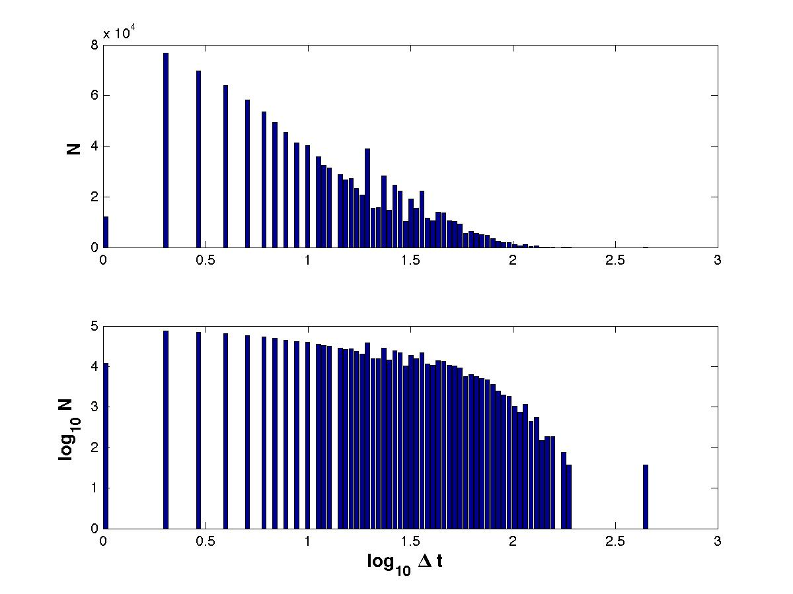
Step 0: Investigate the distribution of sample intervals

Slide 6
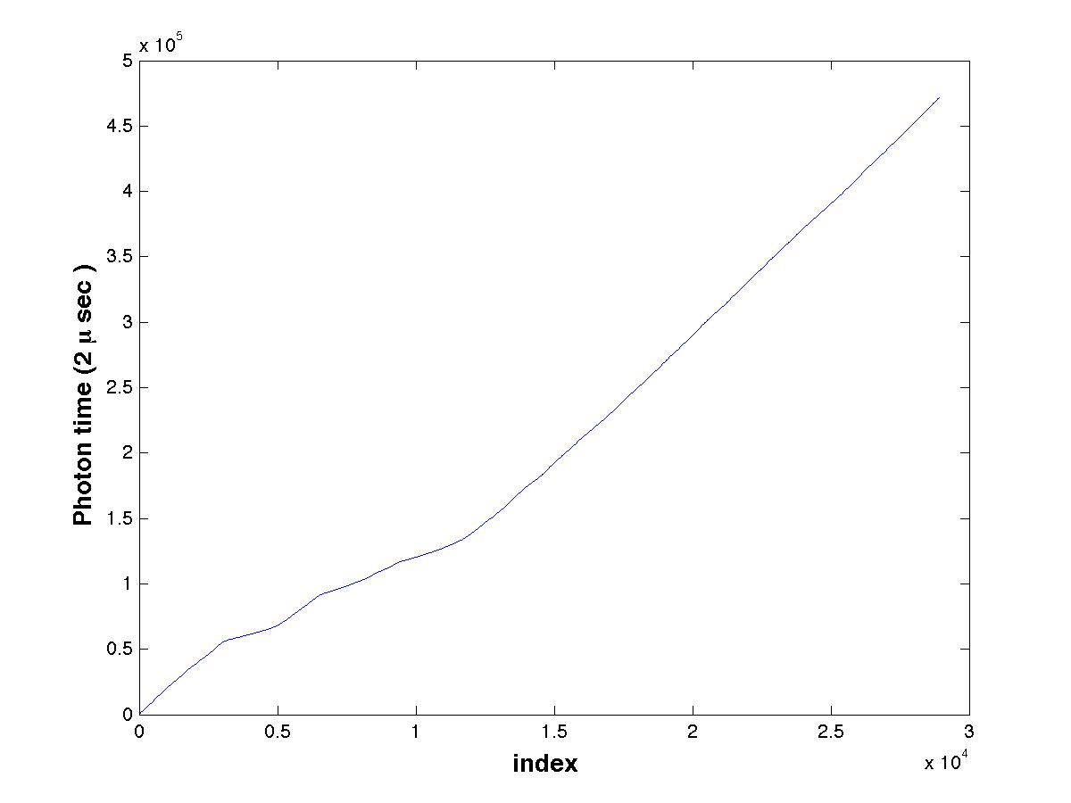

Slide 7
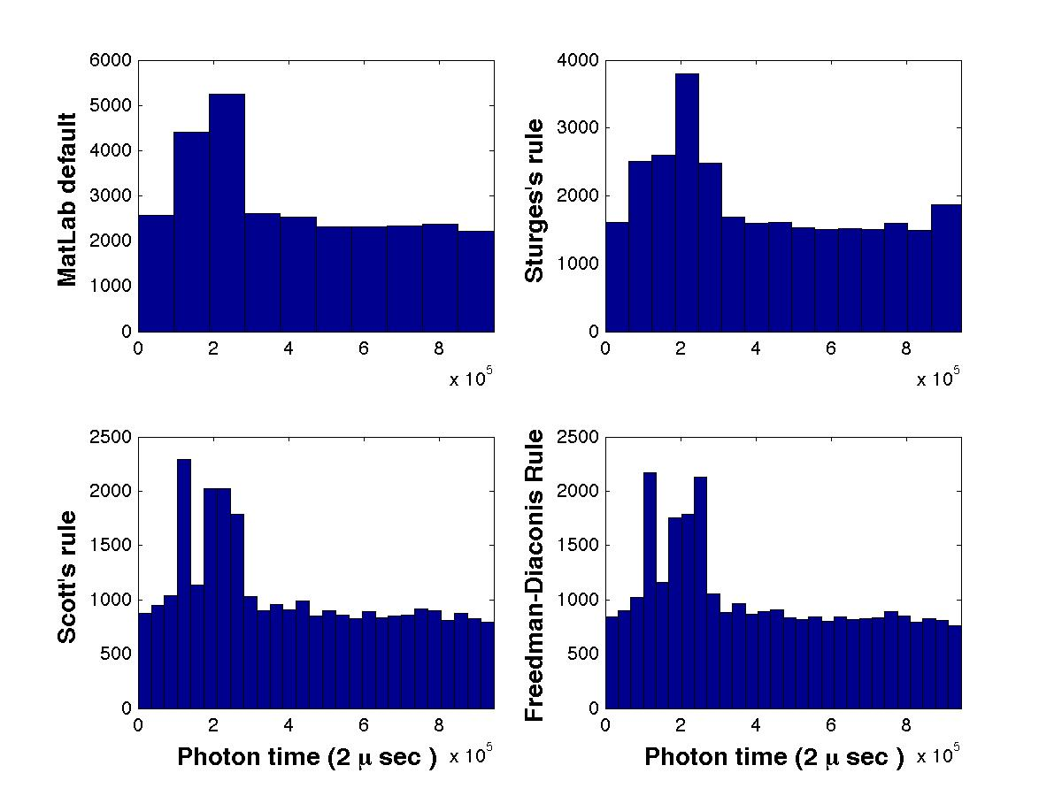

Slide 8
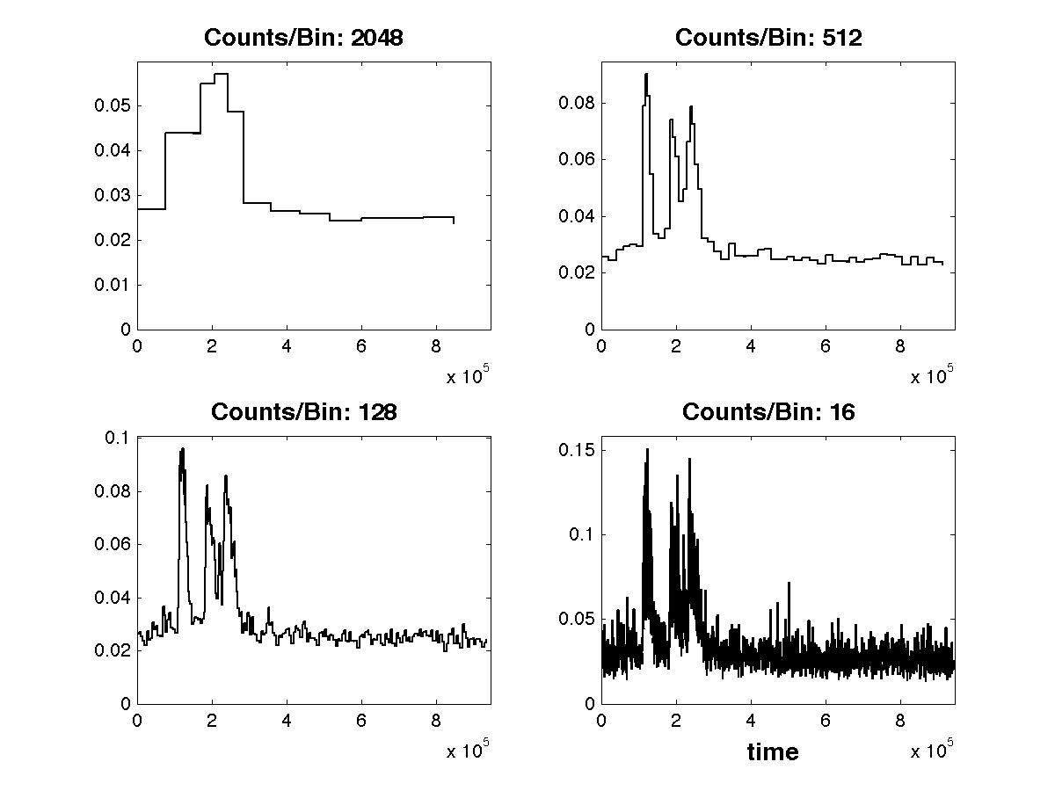

Slide 9
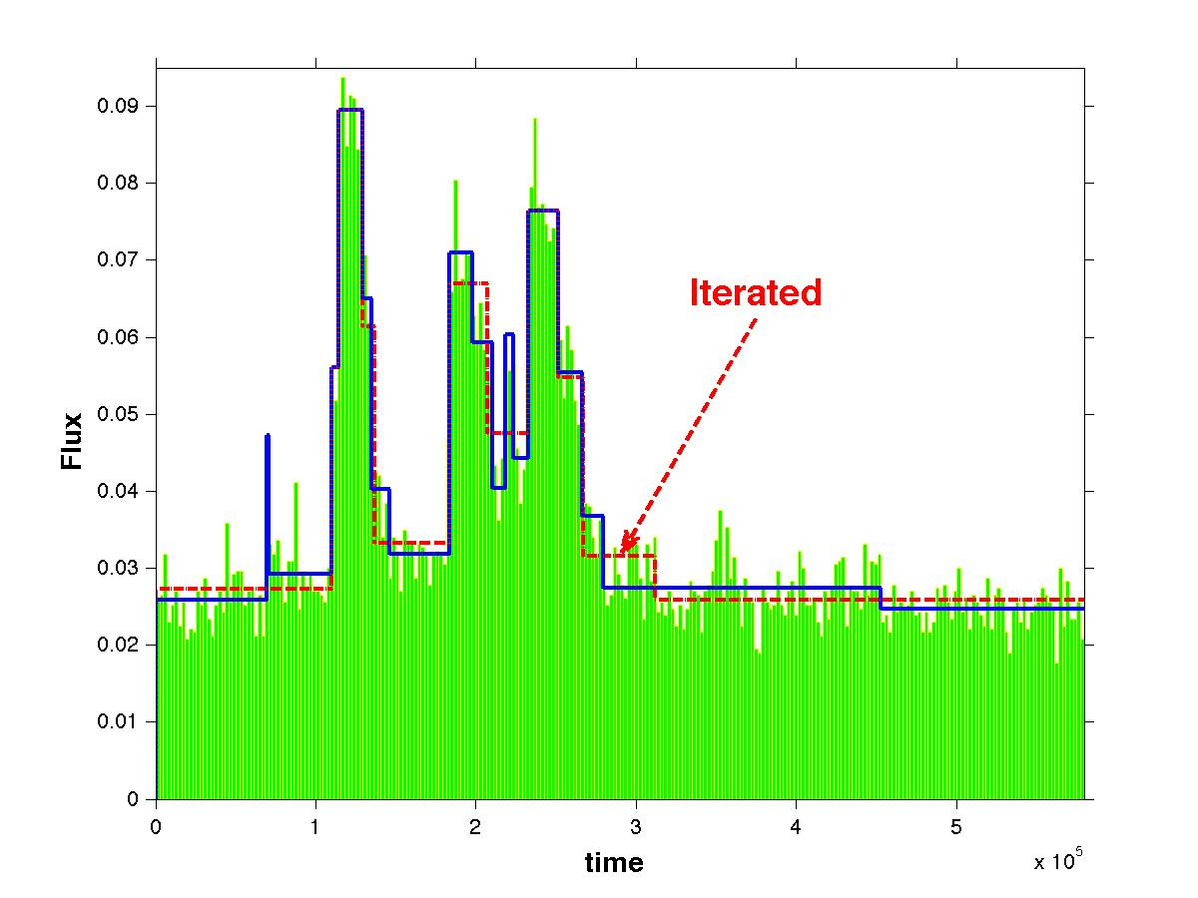
Bayesian Blocks

Slide 10
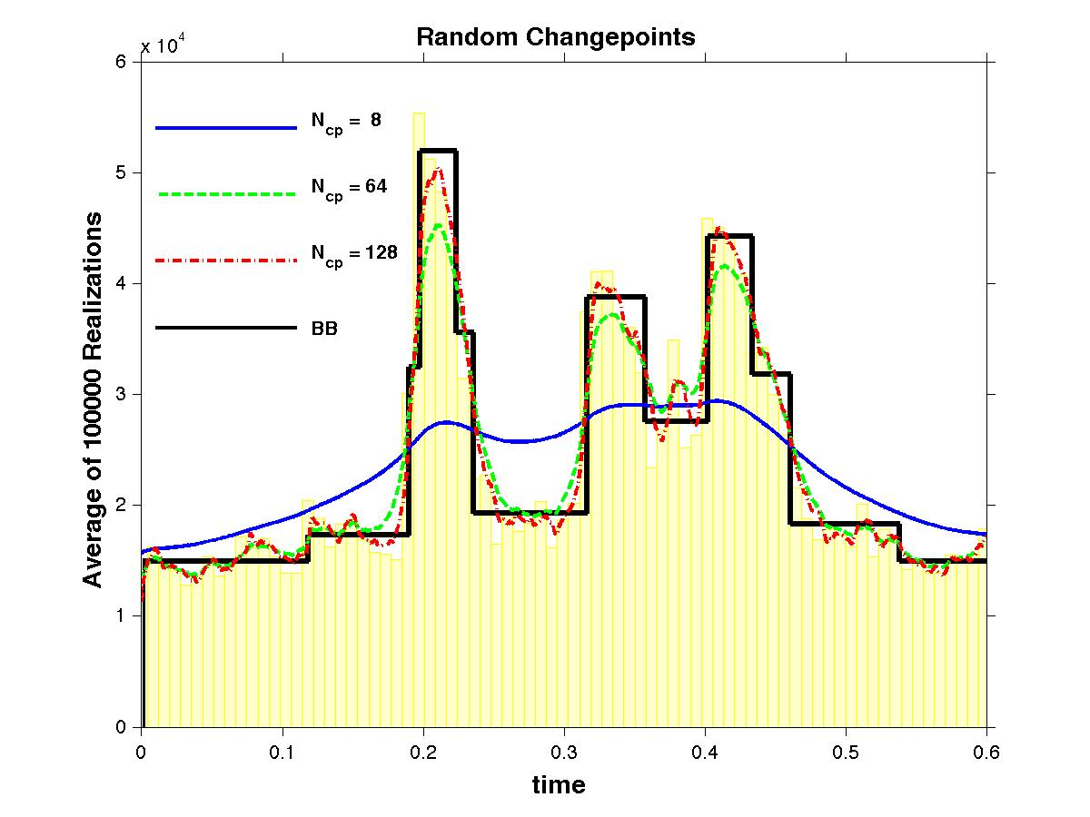

Slide 11
Bayesian Blocks: The Optimizer
best = []; last = [];
for R = 1:num_cells
[ best(R), last(R) ] = max( [0 best] + ...
reverse( log_post( cumsum( data_cells(R:-1:1, :) ), prior, type ) ) );
if first > 0 & last(R) > first % Option: trigger on first significant block
changepoints = last(R); return
end
end
% Now locate all the changepoints
index = last( num_cells );
changepoints = [];
while index > 1
changepoints = [ index changepoints ];
index = last( index - 1 );
end

Slide 12
. . .
Optimum Partition Up To This Point
Prospective Last Block
. . .
. . .

Slide 13
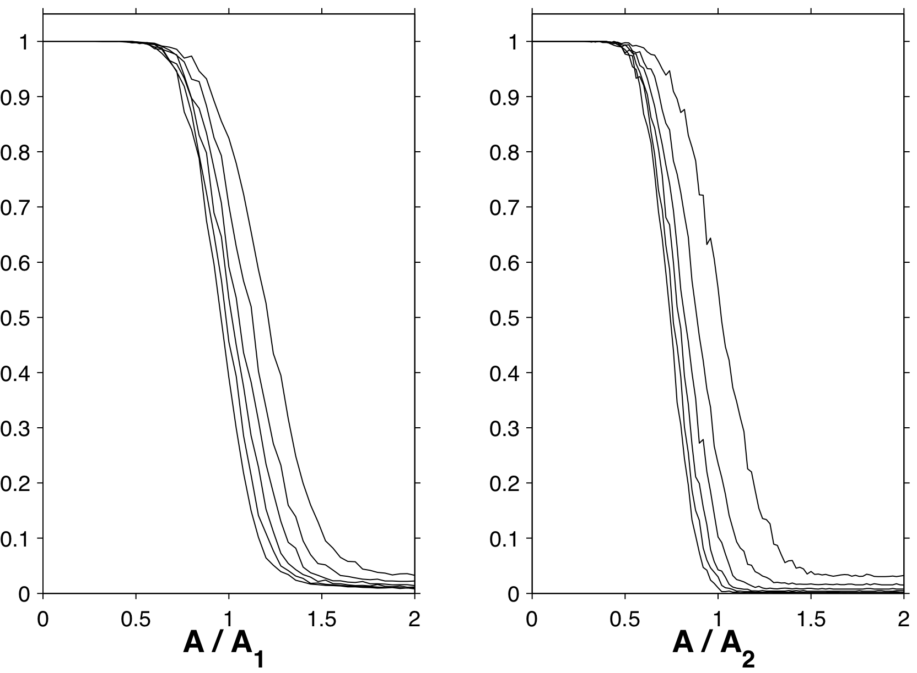
BB Nearly Achieves Theoretical Detection Limit
Detection error rate vs. signal amplitude in units of asymptotic result.
Arias-Castro, E., , Donoho, D., & Huo, X. 2003, Near-Optimal Detection of Geometric Objects by Fast Multiscale Methods
IEEE Transactions on Information Theory, 51, 2402-2425

Slide 14
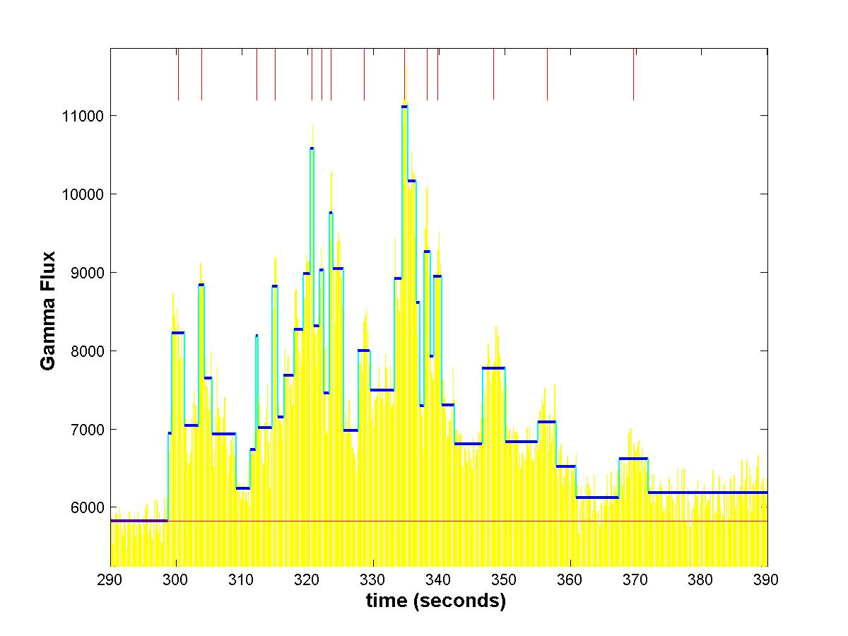
Studies in Astronomical Time Series Analysis. VI. Bayesian Block Representations
Jeffrey D. Scargle, Jay P. Norris, Brad Jackson, James Chiang arxiv.org/abs/1207.5578
Listed in Astrophysics Source Code Library: http://asci.net
Bellman, R. 1961, On the approximation of curves by line segments using dynamic programming, Communications of the ACM, 4, 284.
15 Years of Reproducible Research in Computational Harmonic Analysis.
Donoho, D. et al. 2009, Computing in Science and Engineering, 11, 8
stats.stanford.edu/~donoho/Reports/2008/15YrsReproResch-20080426.pdf

Slide 15
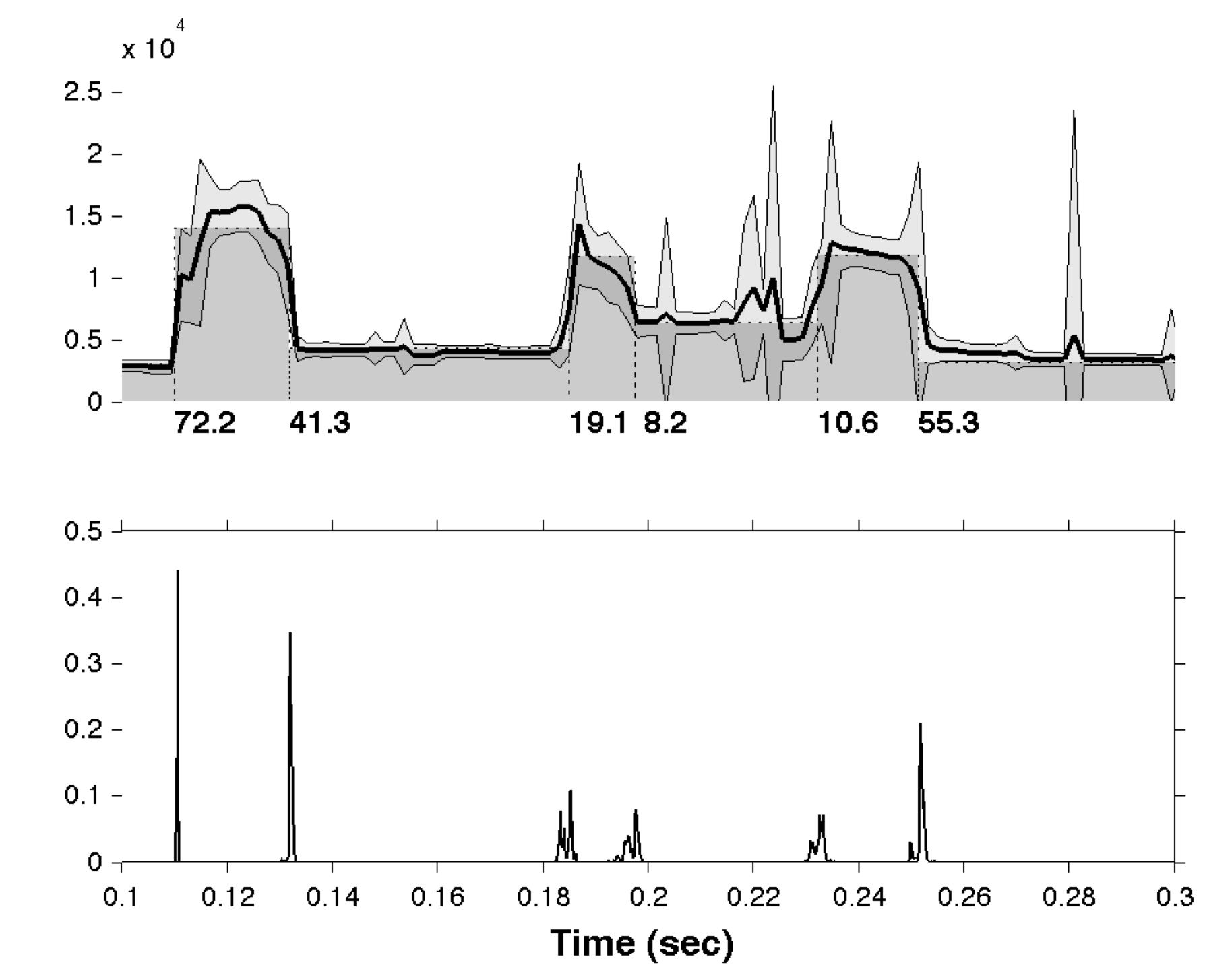
Analysis of Variance
Bootstrap: (apologies to Tom Loredo
and possibly Aletheia)
Single change-point likelihoods

Slide 16
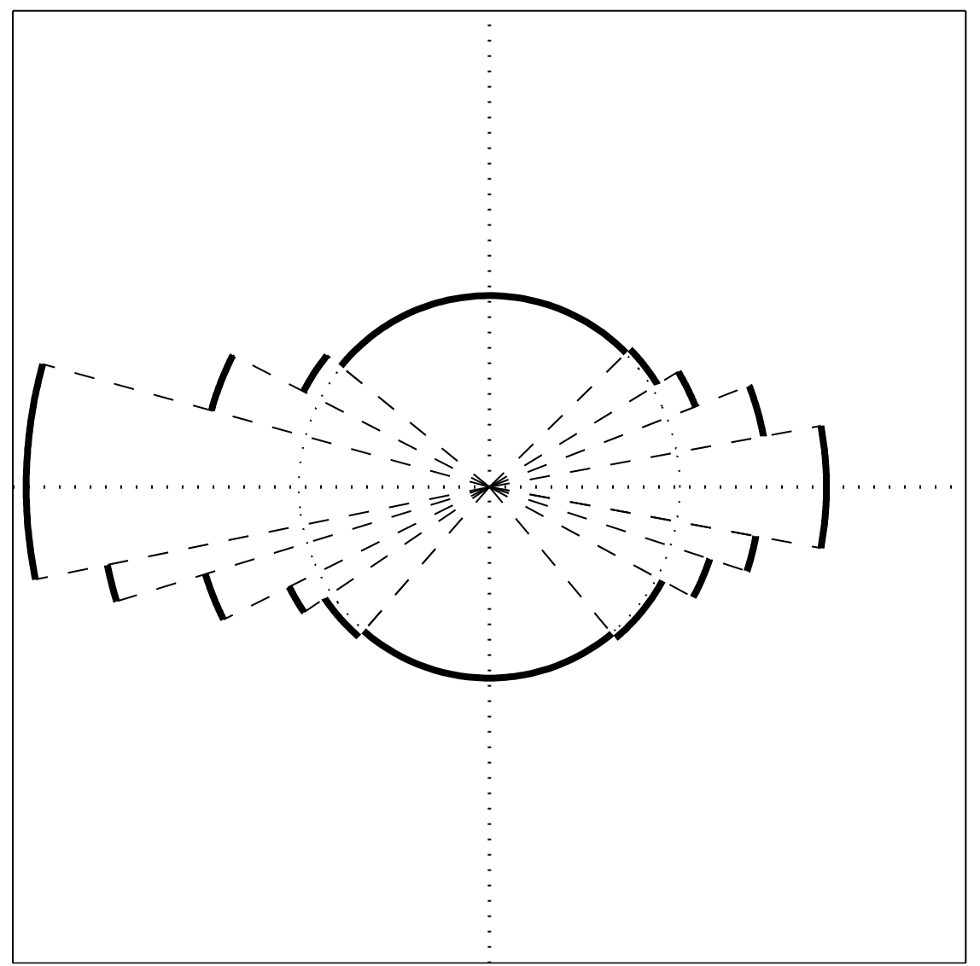
Optimal Partitioning Data on the Circle

Slide 17
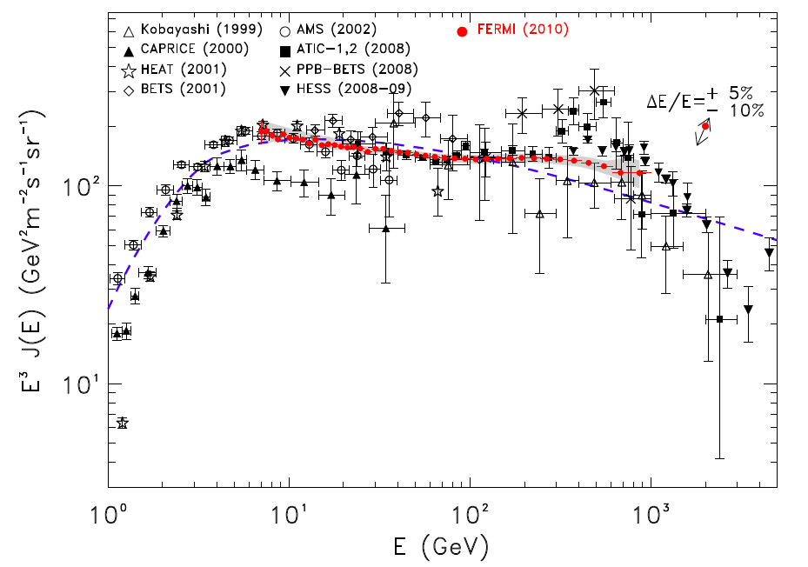
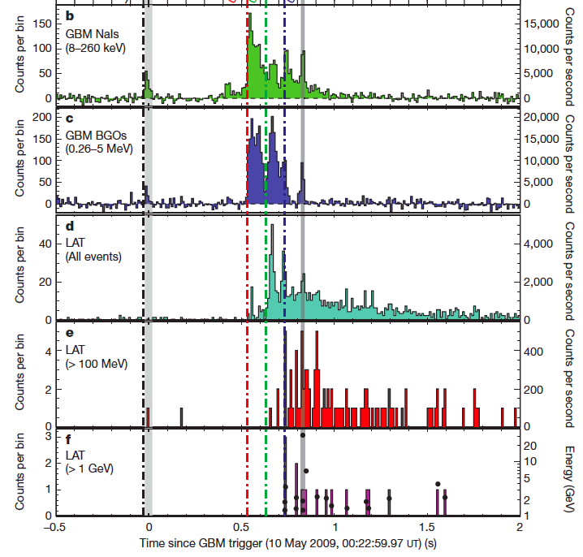
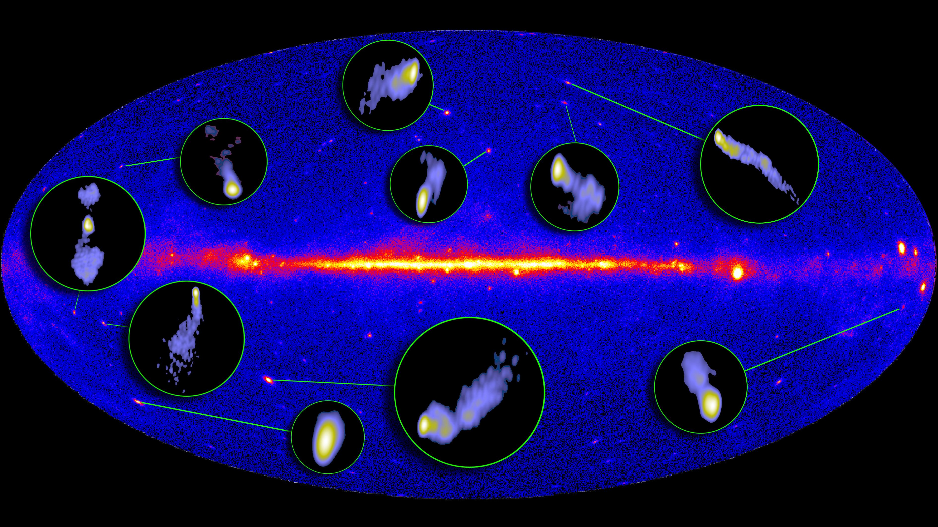
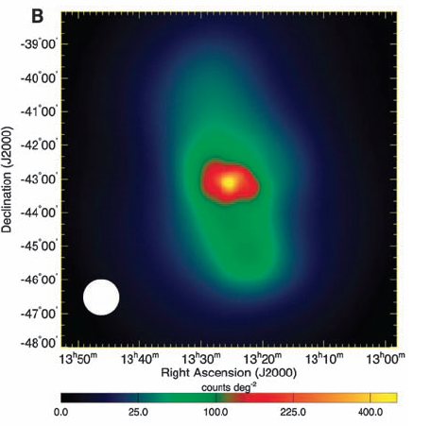
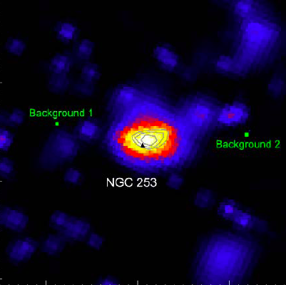
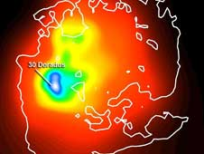
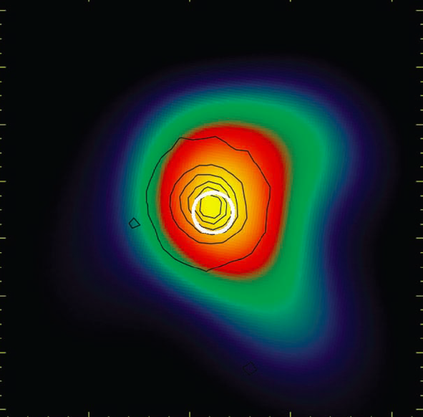
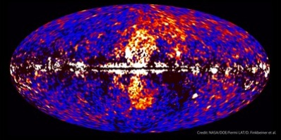
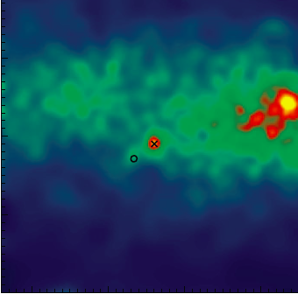
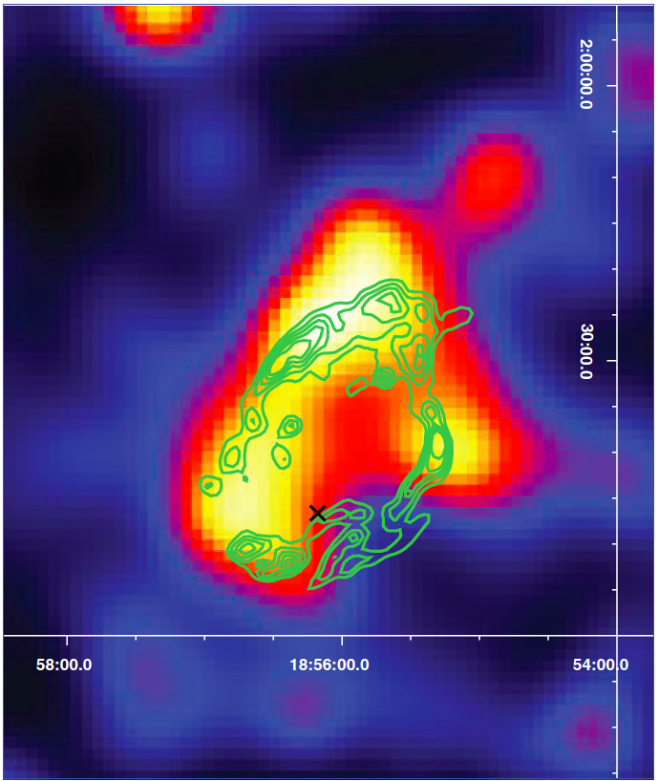
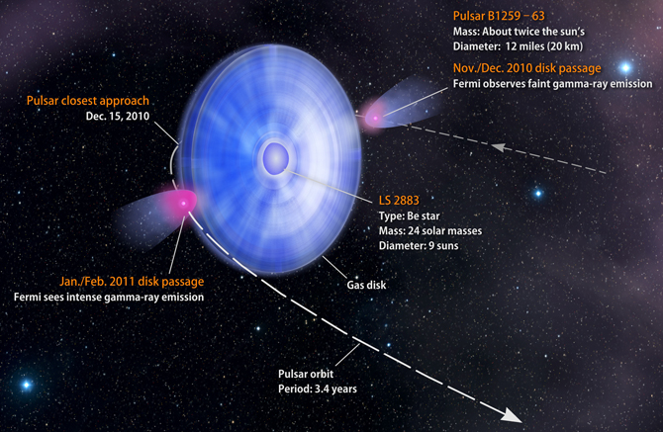
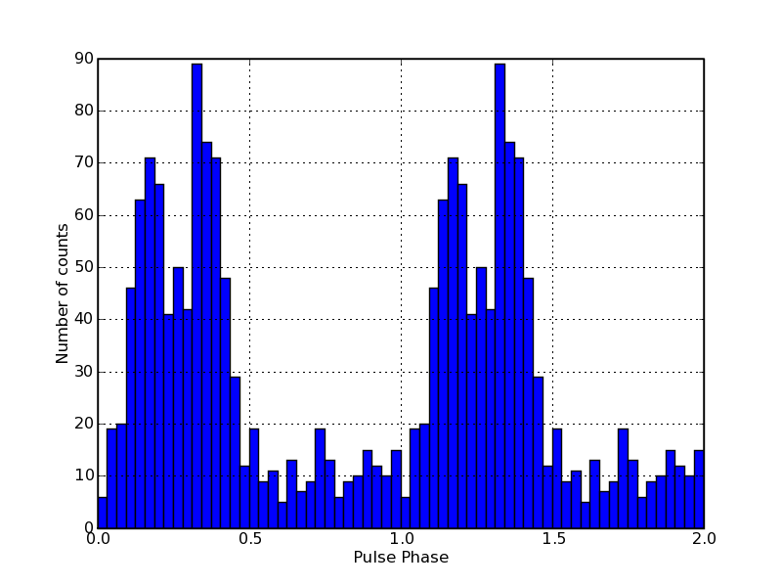
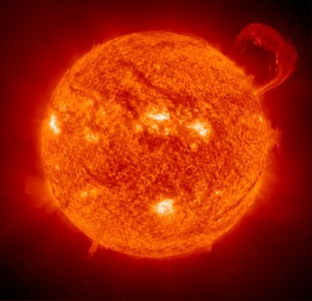
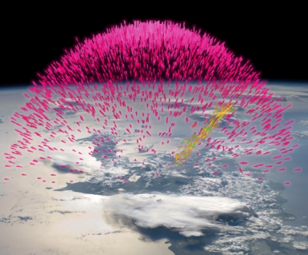
Fermi Highlights and Discoveries
GRBs
e⁺e⁻ spectrum
Blazars (782)
Radio Galaxies (12)
Extragalactic
Star Burst Galaxies (4)
LMC & SMC
Globular Clusters (11)
Fermi Bubbles
Nova (1)
SNRs & PWN (68)
Galactic
γ-ray Binaries (6)
Pulsars: isolated, binaries, & MSPs (122)
Sun: flares & CR interactions
TGFs
Unidentified Sources (600)
Notes:
Change numbers to nearest 10?

Slide 18
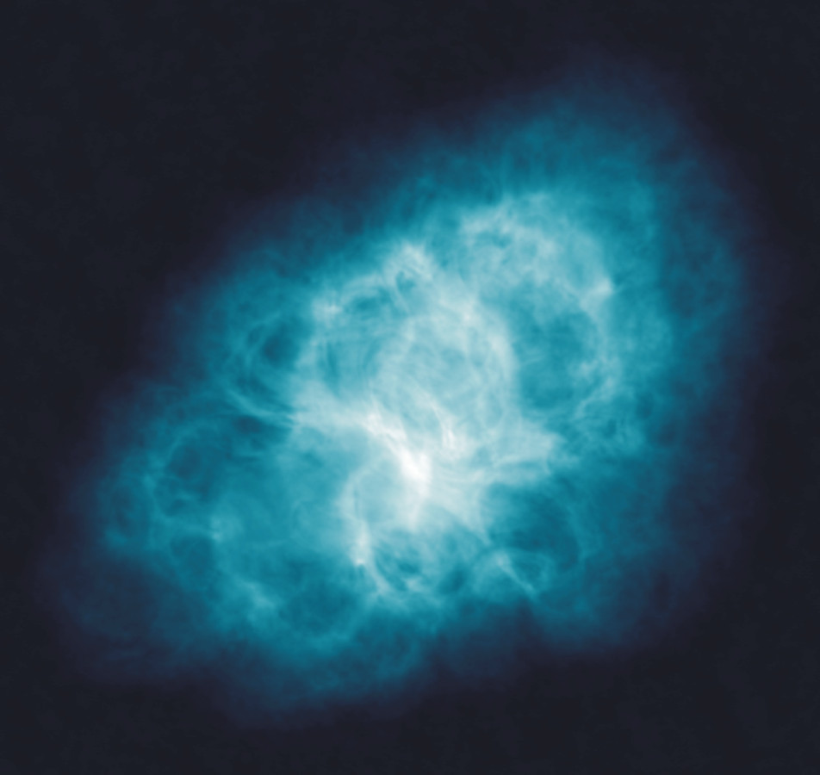
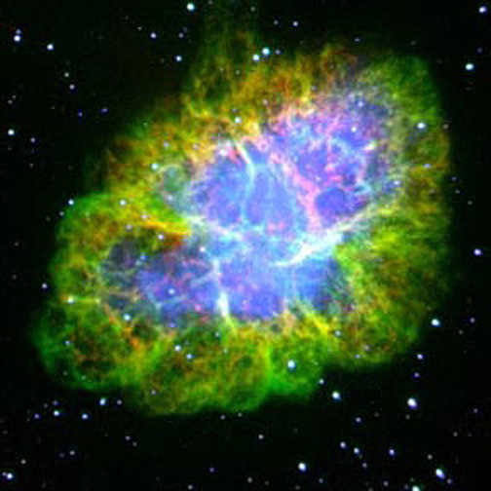
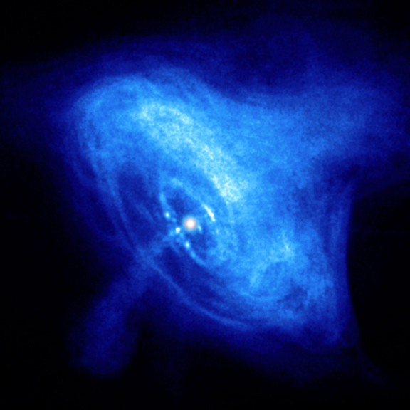
The Crab Nebula
Radio
Optical
NRAO/AUI and M. Bietenholz
NASA/ESA/ASU/J.Hester & A.Loll)
See review
Hester, J. J., 2008,
ARA&A, 46, 127
X-ray
NASA/CXC/ASU/J.Hester et al.
Notes:
Synchrotron nebula ~3x4 pc

Slide 19
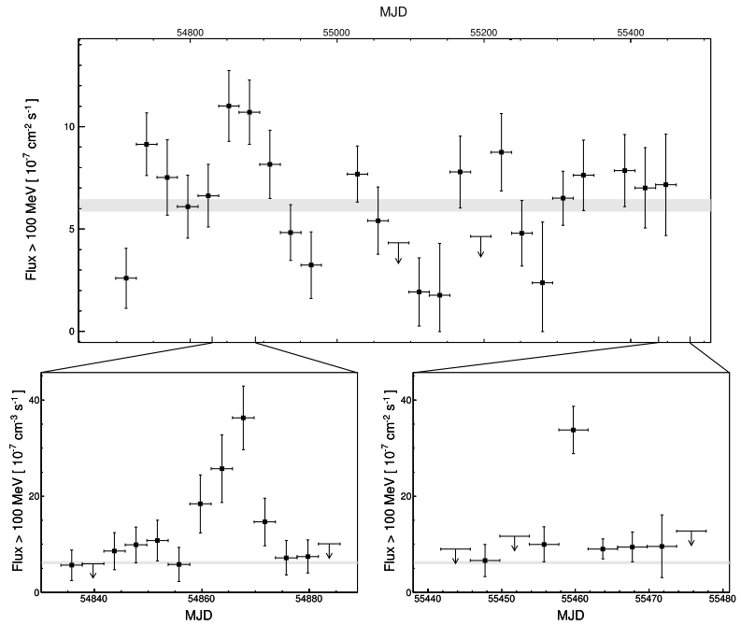
Previous Flares viewed by Fermi LAT
No variability found in pulsar or high energy (IC) LAT component
4 week intervals
Sun passages excluded
Feb 2009
Sept 2010
4 day intervals covering flare periods
Abdo et al. 2011,
Science, 331, 739
Notes:
Flux represents exposure corrected off-pulse analysis (0.52 to 0.87)

Slide 20
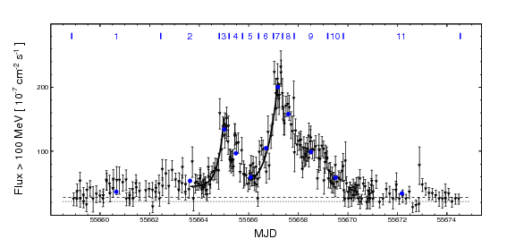
April 2011 Flare
Lightcurve in bins of equal exposure (mean 9 minutes!)
Apr 9
Apr 19
Flux doubling in 8 hours constrains emission region size <0.0003 pc
Beginning of LAT TOO
Buehler, R. et al. 2011, ApJ
Notes:
Point out Chandra obs?VLA?

Slide 21
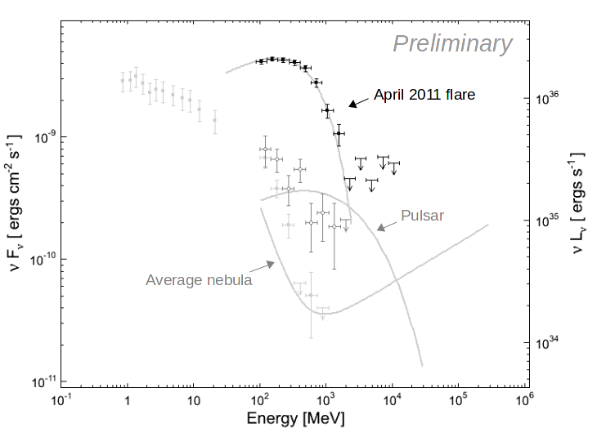
Spectrum during the April 2011 flare
Flare is well described by additional power-law component that cuts off with energy
Photon index
~-1.3
Energy of peak
~375 MeV
Sept 2010
Feb 2009
Energies above ~250 MeV exceed expected maximum for the electron synchrotron process

Slide 22
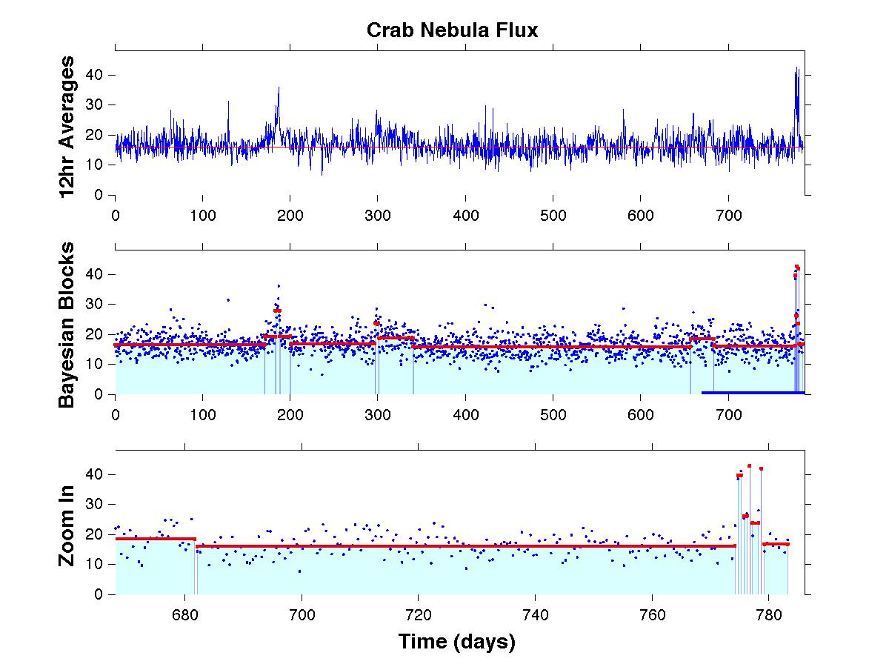
Most likely of the 10⁴⁶⁸ possible segmentations of these 1554 data points!

Slide 23
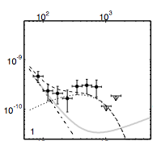
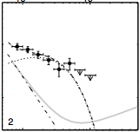
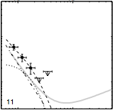
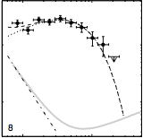
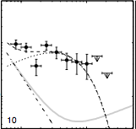
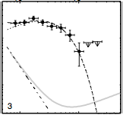
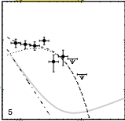
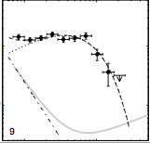
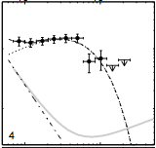
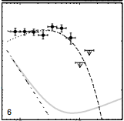
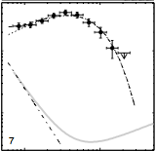
Spectral Evolution
“Sufficient statistics to partition the spectral fit. Bins of constant flux defined by Bayesian Blocks analysis.”
Notes:
Reference paper by ?
Bin widths … 4 days to ~12 hours
Shape stable within statistics.

Slide 24
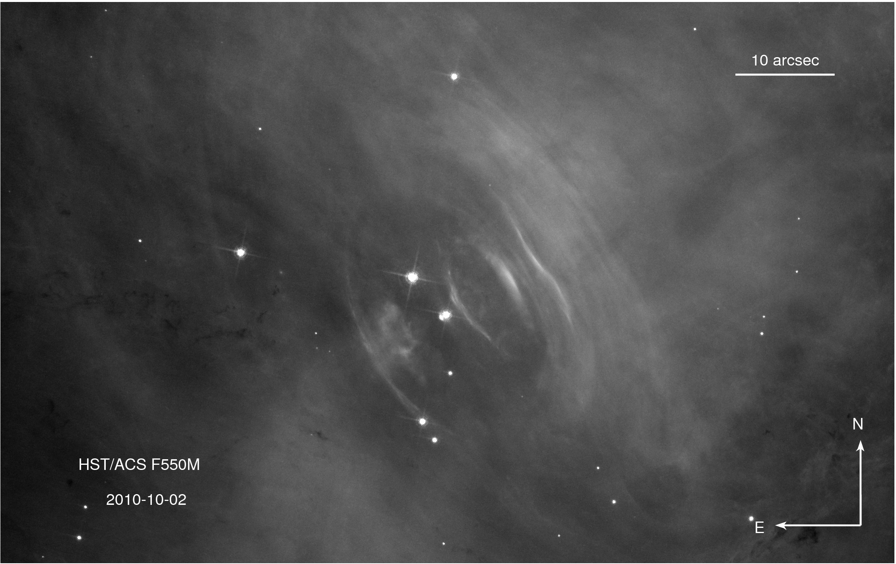
Searching for the Emission Region Sept 2010
P. Caraveo et al. ATEL #2903
No corresponding variability found in radio, optical, infrared, soft and hard X-rays around time of Sept. 2010 flare.
Notes:
Chandra, VLA
Chandra coverage throughout April 2011 flare

Slide 25
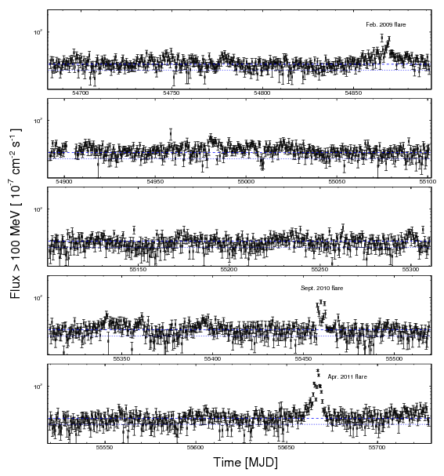
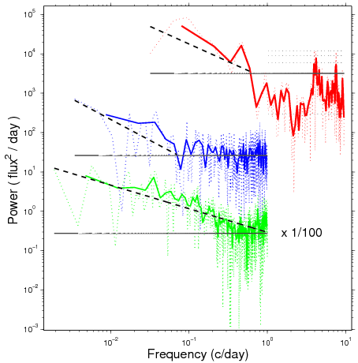
Persistent Variability
Feb. 2009
Flare
Non-flare
All
Sept. 2010
LAT data show variability (weeks to years) over full lightcurve and outside of flare periods.
Apr. 2011
Notes:
12 hour bins
Fit

Slide 26
Summary
Fast, high-energy flares from the Crab are a largely gamma-ray phenomena
Electrons reach very high energy in a very short time (8 hour flux doubling time)
Where do the gamma rays originate in the nebula?
  No pulsations -> outside the pulsar light cylinder
  0.0003 pc constraint is smaller than the termination shock region
  Despite good coverage, no correlated variations or changes in features yet found at other wavelengths
Rapid variability and high energy suggest relativistic beaming of electron synchrotron
Time scale and small region imply electrons accelerated through electrostatic acceleration or magnetic reconnection
Nebula is highly dynamic over the spectrum, but not clear how to connect features and timescales
Future observations of large flares may help further pinpoint the emission site

Slide 27
Algorithm Categories …
Time Domain (local)
  Nonparametric models
  Bayesian Blocks (piecewise constant, linear, or exponential)
  Symbolic Representation
  Parametric model fitting
Frequency/Scale Domain (global)
  Power Spectrum
  Correlation Function
  Structure Function
  Wavelet Spectrum
Time-Frequency/Time Scale Domain (hybrid)
  Time-frequency distribution
  Wavelet transform

Slide 28
Cross- and Auto- Correlation Functions for unevenly spaced data
Edelson and Krolik: “The Discrete Correlation Function: a New Method for Analyzing Unevenly Sampled Variability Data” Astrophysical Journal 333 (1988) 646
ρ_{xy}(τ) = (1/N_{k}) Σ X(t_{n}) Y(t_{m}) for t_{n} – t_{m} in τ bin

Slide 29
Data Mode
Photon events
Time-to-Spill
Counts in bins
Flux measurements
Any Mode/Sampling!
Auto-
Correlation Function
Fourier Power Spectrum
Fourier Phase Spectrum
Wavelet scalgram
Wavelet scaleogram
Structure Function
Time-Frequency Distribution
Time-Scale Distribution
…
Universal
Time Series
Analysis Machine
Extension of Edelson & Krolik
Algorithm for Correlation Function
of Unevenly Sampled Data
Jeff Scargle

Slide 30
Data Mode
Photon events
Time-to-Spill
Counts in bins
Flux measurements
Any Mode/Sampling!
Cross-
Correlation Function
Fourier Power Spectrum
Fourier Phase Spectrum
Wavelet scalgram
Wavelet scaleogram
Structure Function
Time-Frequency Distribution
Time-Scale Distribution
…
Universal
Time Series
Analysis Machine
any combination
Photon events
Time-to-Spill
Counts in bins
Flux measurements
Any Mode/Sampling!
Extension of Edelson & Krolik
Algorithm for Correlation Function
of Unevenly Sampled Data
Jeff Scargle

Slide 31
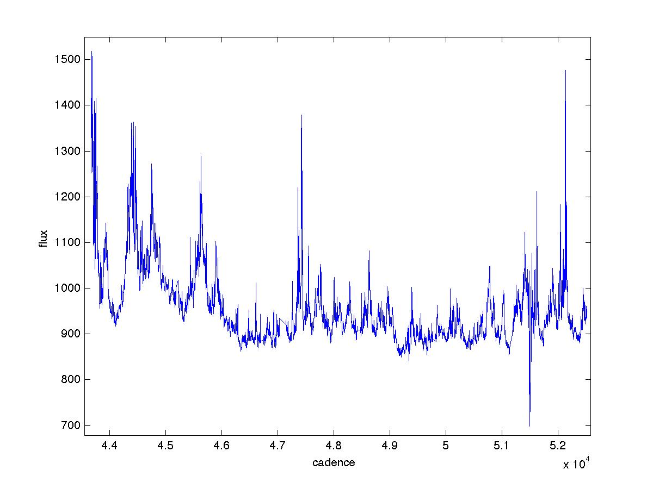
Kepler observations of rapid optical variability in the BL Lac object W2R1926+42
R. Edelson, R. Mushotzky, S. Vaughan, J. Scargle, P. Gandhi, M. Malkan, W. Baumgartner

Slide 32
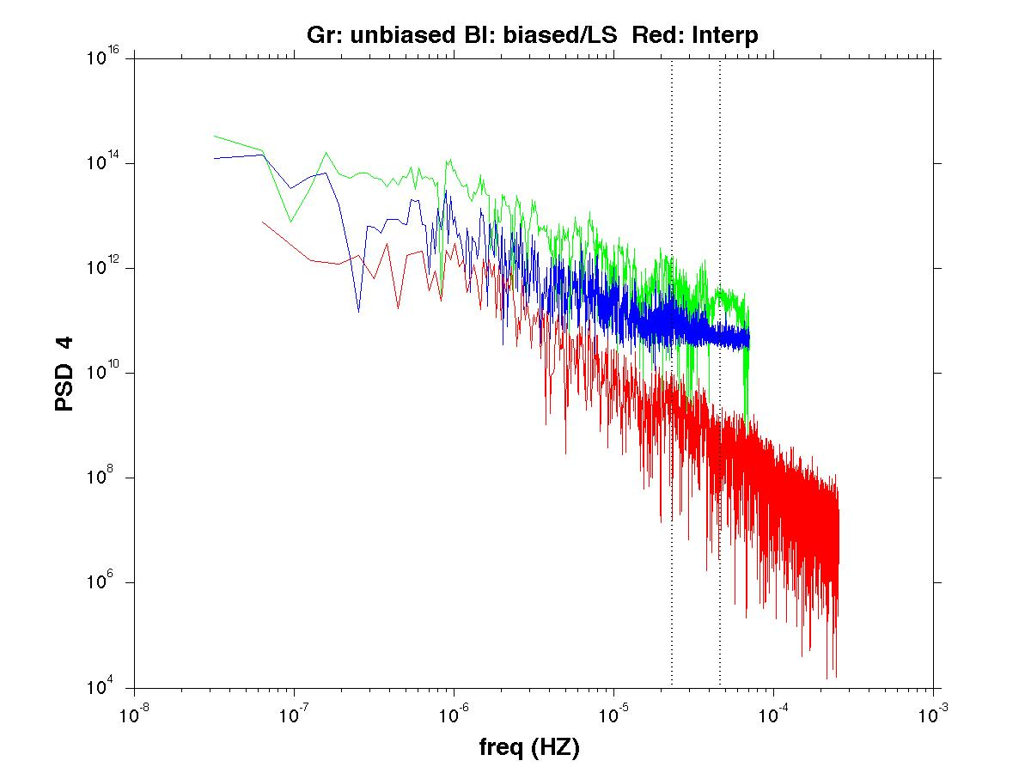

Slide 33
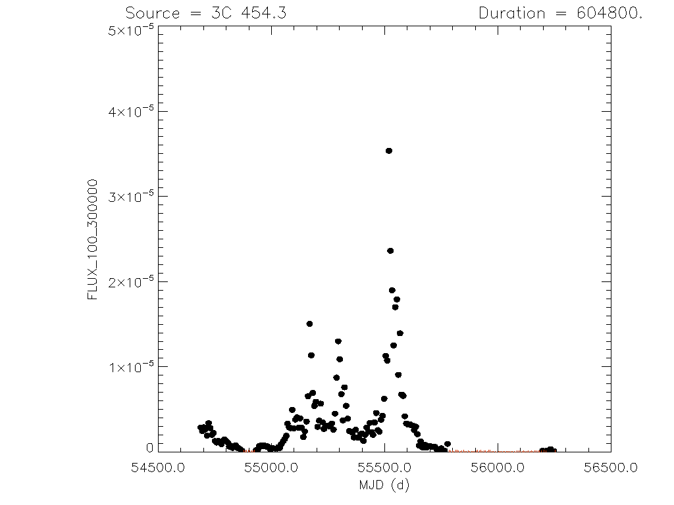

Slide 34
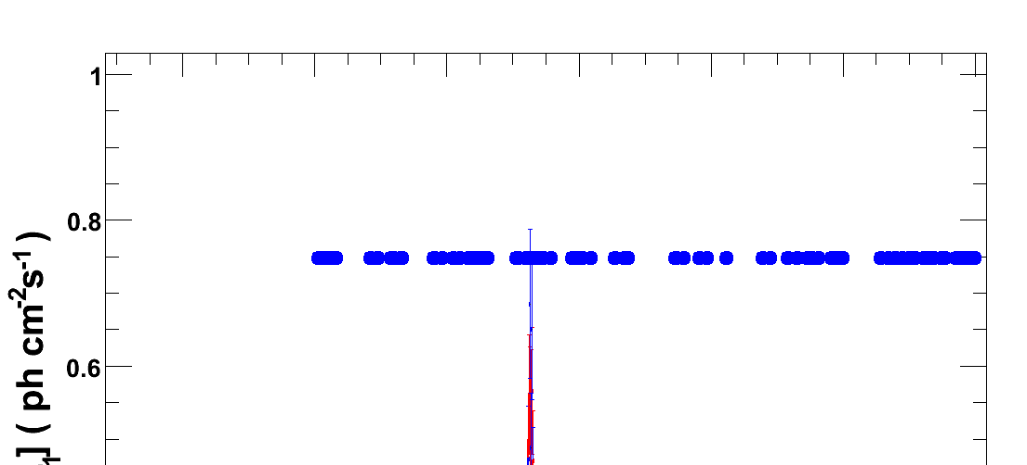


Slide 35
Solar Cycle Variability and
Surface Diﬀerential Rotation from
Ca II K-Line Time Series Data
Jeff Scargle, Ames Research Center
Stephen Keil, National Solar Observatory
Pete Worden, Ames Research Center
Submitted to Astrophysical Journal

Slide 36
Ca II K-line Monitoring Program
National Solar Observatory/Sacramento Peak disk-integrated Calcium II K-line data
November 1976 – December 2012
Data: http://nsosp.nso.edu/data/cak_mon.html
Keil, Henry and Fleck, Synoptic Solar Physics, ASP Conference Series (1998)

Slide 37


Slide 38
Measured K-line Parameters
EM : Emission Index: equivalent width in 1Å band centered on core
K₃ : Intensity in the core
K_{2V}/K₃ : Relative strength of blue K₂ emission peak relative to K₃
K_{2V}-K_{2R} : Separation of blue and red K₁ emission maxima
K_{1V}-K_{1R} : Separation of blue and red K₁ minima
K_{2V}/K_{2R} : Line asymmetry, ratio of blue/red emission peaks
WB : Wilson-Bappu parameter, width between outer edges of emission peaks

Slide 39

Lots of Data Gaps!
Log N
A few more

Slide 40


Slide 41


Slide 42


Slide 43


Slide 44


Slide 45


Slide 46

Synchrosqueezing Algorithm: Brevdo and Daubechies

Slide 47
Processes Underlying K-line Variations
 | Amplitude | Time Scale | Nature
Solar Cycle | Large | Long (~ 11 years) | Deterministic
Rieger Periodicity etc. | Medium | Intermediate (~ 100 days) | Quasi-Periodic
Flicker Noise | Small | Short (<~ year) | Random
(Differential) Rotational Modulation | Medium | Short (~ 27 days) | Quasi Periodic
Observation Errors | Small | Instantaneous | Random

Slide 48



Slide 51
Function | Domain | Range | Auto- | Cross- | Physical Interp
Bayesian blk. Light Curve | Time | Flux | ✔ | ✔ multivar. BB | Flares, events etc.
Scatter Plot | Flux 1 | Flux 2 |  | ✔ | Dependency (not just cor.)
Correlation | Lag | <X²> <XY> | ✔ | ✔ | Correlated behavior/lags
Spectrum | Frequency | Power | ✔ | ✔ | Periodicity 1/f noise …
 |  | Phase | ✔ | ✔ | Shifts, lags
Structure | Lag | <X²> <XY> | ✔ | ✔ | Correlated behavior/lags
Scalogram | Scale/Time | Power | ✔ | ✔ | Dynamic behavior
Scalegram | Scale | Power | ✔ | ✔ | 1/f noise QPOs
Distribution | Time/scale/ frequency | Power | ✔ | ✔ | Dynamic behavior

Slide 52


Slide 53
Bayesian Blocks Bibliogrpahy
Studies in Astronomical Time Series Analysis.
VI. Bayesian Block Representations
Scargle, J., Norris, J., Jackson, B. and Chiang, J.
The Astrophysical Journal, 764, 167 (2013)
Our Blog: http://bayesianblocks.blogspot.com/
Jake Vanderplas’ Blog Dynamic Programming in Python: Bayesian Blocks
http://jakevdp.github.com/blog/2012/09/12/dynamic-programming-in-python/
Starship Asterisk* APOD and General Astronomy Discussion Forum
Bayesian Blocks: Detecting local variability in time series
http://asterisk.apod.com/viewtopic.php?f=35&t=29458
An algorithm for optimal partitioning of data on an interval
Jackson, Scargle, Barnes, Arabhi, Gioumousis, Gwin, Sangtrakulcharoen, Tan, Tun Tao Tsai
IEEE Signal Processing Letters, 2005, 12, 105
Studies in Astronomical Time Series Analysis.
V. Bayesian Blocks, a New Method to Analyze Structure in Photon Counting Data
Scargle, 1998, Astrophysical Journal, 504, 405

